Slide 1
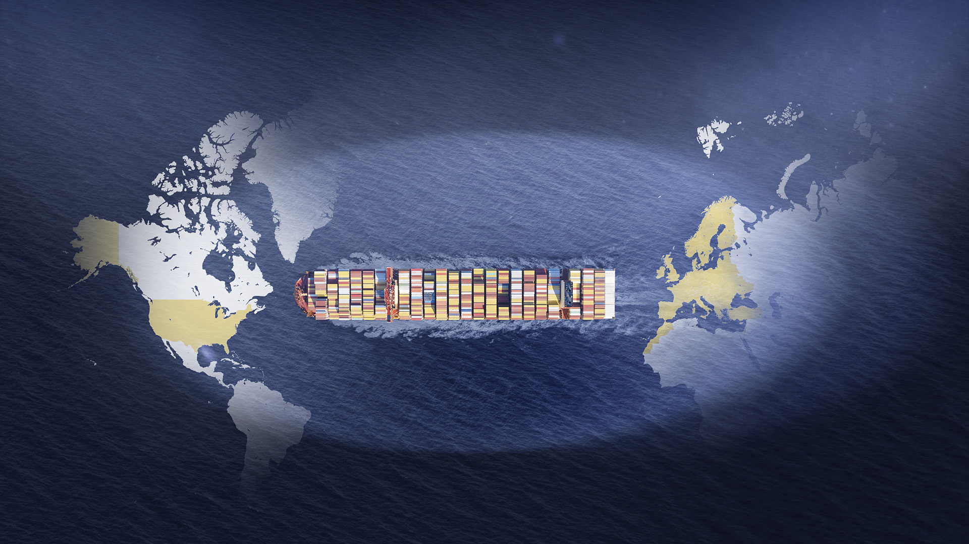

Transatlantic services
EUROPE-USA
February 2026
External

Slide 2
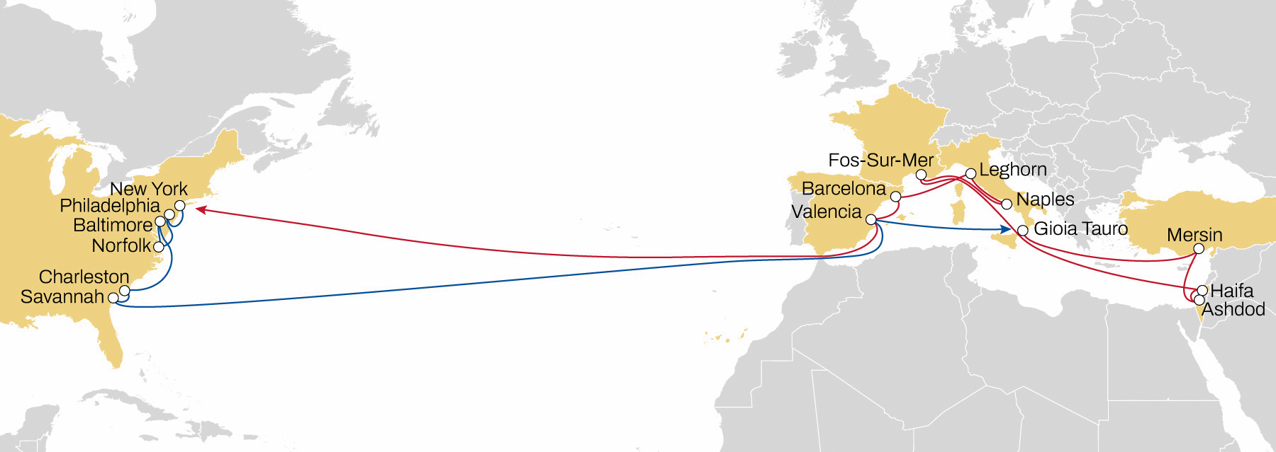
TÜRKIYE/WMED to USA east coast
EMUSA
Weekly sailings
Exclusive link ex Main MED origins to all USEC
Unique coverage from north and south of Italy to Philadelphia, Baltimore and main USEC
Best transit times in the market to New York and Savannah
Transit Time | Arrival
Departure | New York | Philadelphia | Norfolk | Baltimore | Charleston | Savannah
Ashdod | 26 | 29 | 31 | 33 | 37 | 38
Haifa | 25 | 28 | 30 | 32 | 36 | 37
FOS | 18 | 21 | 23 | 25 | 29 | 30
Naples | 15 | 18 | 20 | 22 | 26 | 27
Leghorn | 13 | 16 | 18 | 20 | 24 | 25
Barcelona | 11 | 14 | 16 | 18 | 22 | 23
Valencia | 9 | 12 | 14 | 16 | 20 | 21
Note: Transit times are indicative and subject to change, please visit msc.com
To ensure you have the latest version of our flyers, please register online to get the latest updates as soon as they’re available.

Slide 3
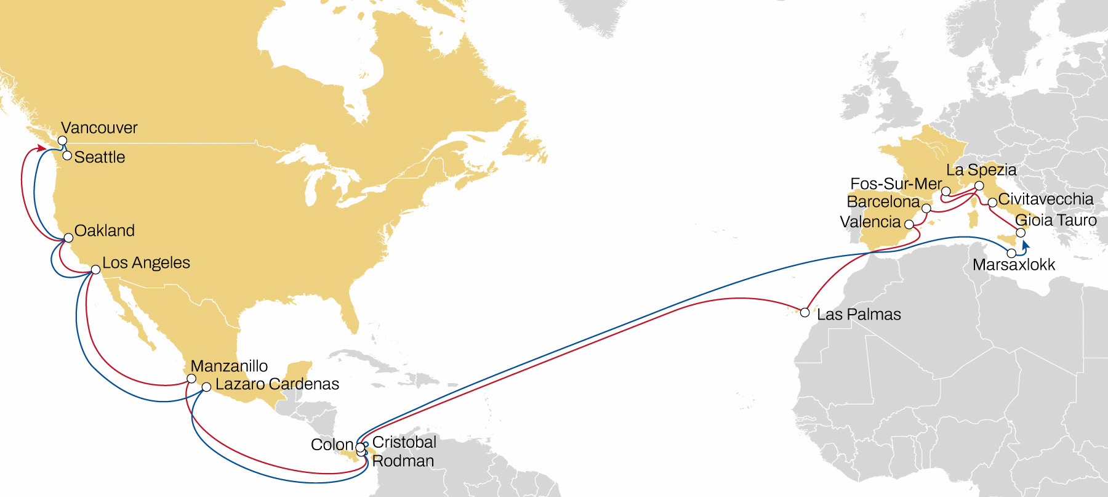

West med to north america pacific
California express
Weekly sailings
Exclusive all water service from Mediterranean to North America West Coast
Seattle destination as MSC exclusive call
Transit Time | Arrival
Departure | Manzanillo | Los Angeles | Oakland | Seattle | Vancouver
Gioia Tauro | 36 | 41 | 43 | 50 | 52
Civitavecchia | 33 | 38 | 40 | 47 | 49
Fos-sur-Mer | 30 | 35 | 37 | 44 | 46
La Spezia | 27 | 32 | 34 | 41 | 43
Barcelona | 25 | 30 | 32 | 39 | 41
Valencia | 23 | 28 | 30 | 37 | 39
Las Palmas | 18 | 22 | 25 | 31 | 35
Note: Transit times are indicative and subject to change, please visit msc.com
To ensure you have the latest version of our flyers, please register online to get the latest updates as soon as they’re available.

Slide 4
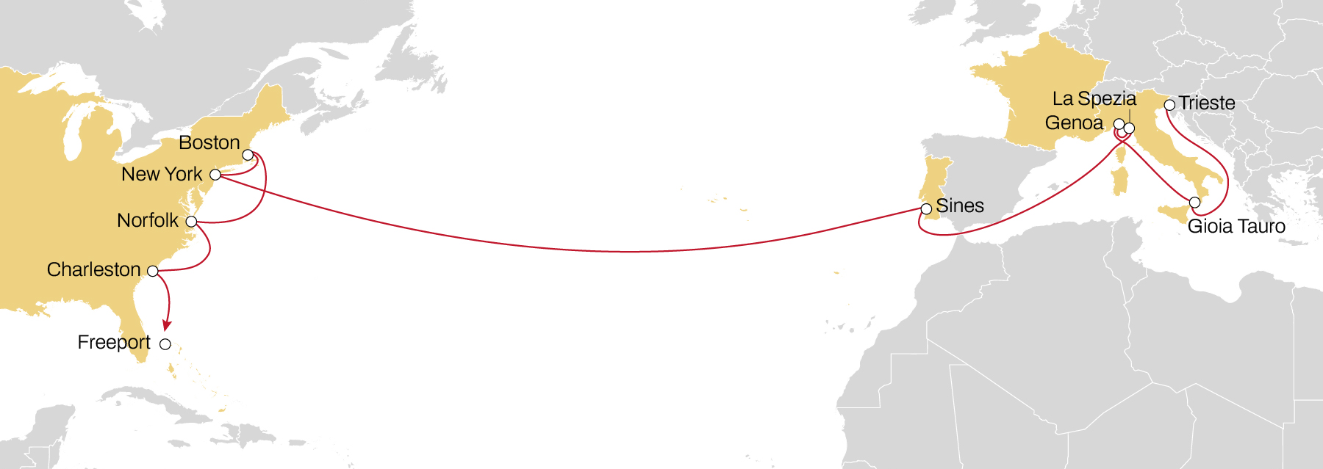
DRAGON
Weekly sailings
Exclusive link from Italy, France and Portugal to Main USEC ports
Transit Time | Arrival
Departure | New York | Boston | Norfolk | Charleston | Freeport
Trieste | 21 | 25 | 28 | 32 | 34
Gioia Tauro | 17 | 21 | 24 | 28 | 30
Genoa | 13 | 17 | 20 | 24 | 26
La Spezia | 12 | 16 | 19 | 23 | 25
Sines | 7 | 11 | 14 | 18 | 20
Note: Transit times are indicative and subject to change, please visit msc.com
To ensure you have the latest version of our flyers, please register online to get the latest updates as soon as they’re available.

Slide 5
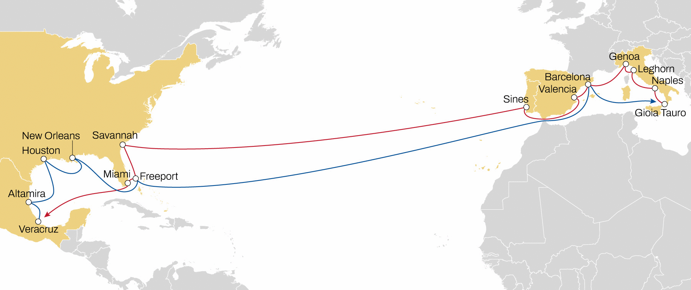
West Med to usa south & gulf
Medgulf SERVICE
Weekly sailings
Full USA Gulf and Mexico direct coverage from Italy, Spain and Portugal
Best transit times in the market to Savannah and Miami
Unique coverage from west med to Bahamas
Transit Time |  | Arrival
Departure | Savannah | Freeport | Miami | Veracruz | Altamira | Houston | New Orleans
Gioia Tauro | 24 | 26 | 27 | 31 | 32 | 35 | 39
Naples | 21 | 23 | 24 | 28 | 29 | 32 | 36
Leghorn | 18 | 20 | 21 | 25 | 26 | 29 | 33
Genoa | 16 | 18 | 19 | 23 | 24 | 27 | 31
Barcelona | 14 | 16 | 17 | 21 | 22 | 25 | 29
Valencia | 12 | 14 | 15 | 19 | 20 | 23 | 27
Sines | 9 | 11 | 12 | 16 | 17 | 20 | 24
Note: Transit times are indicative and subject to change, please visit msc.com
To ensure you have the latest version of our flyers, please register online to get the latest updates as soon as they’re available.

Slide 6
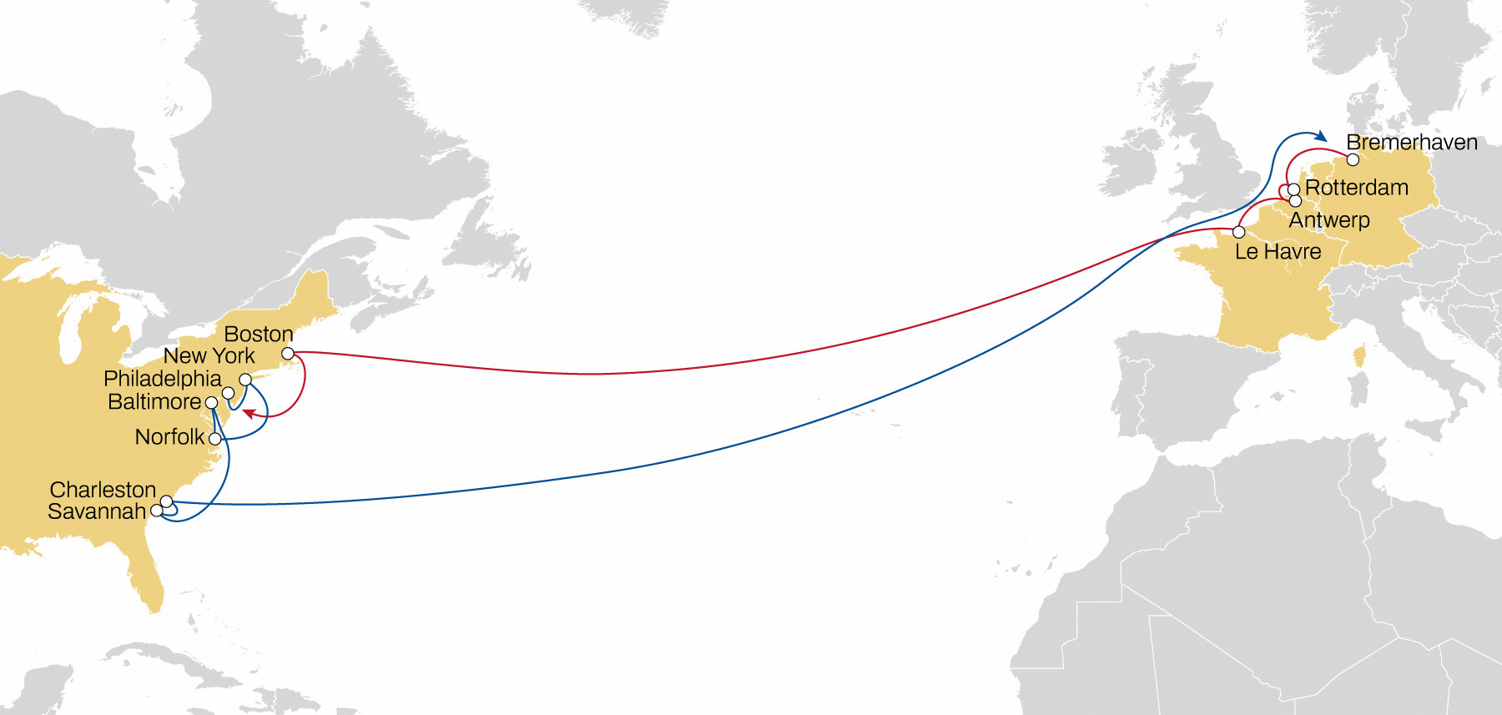
NWC TO USA
NEUSEC 2
Weekly sailings
Best connection and transit times from Antwerp, France (Le Havre) to USA East Coast
Transit Time | Arrival
Departure | Boston | Philadelphia | New York | Norfolk | Baltimore | Savannah | Charleston
Bremerhaven | 15 | 17 | 19 | 21 | 23 | 26 | 27
Rotterdam | 13 | 15 | 17 | 19 | 21 | 24 | 25
Antwerp | 11 | 13 | 16 | 18 | 20 | 23 | 24
Le Havre | 9 | 11 | 13 | 15 | 17 | 20 | 21
Note: Transit times are indicative and subject to change, please visit msc.com
To ensure you have the latest version of our flyers, please register online to get the latest updates as soon as they’re available.

Slide 7
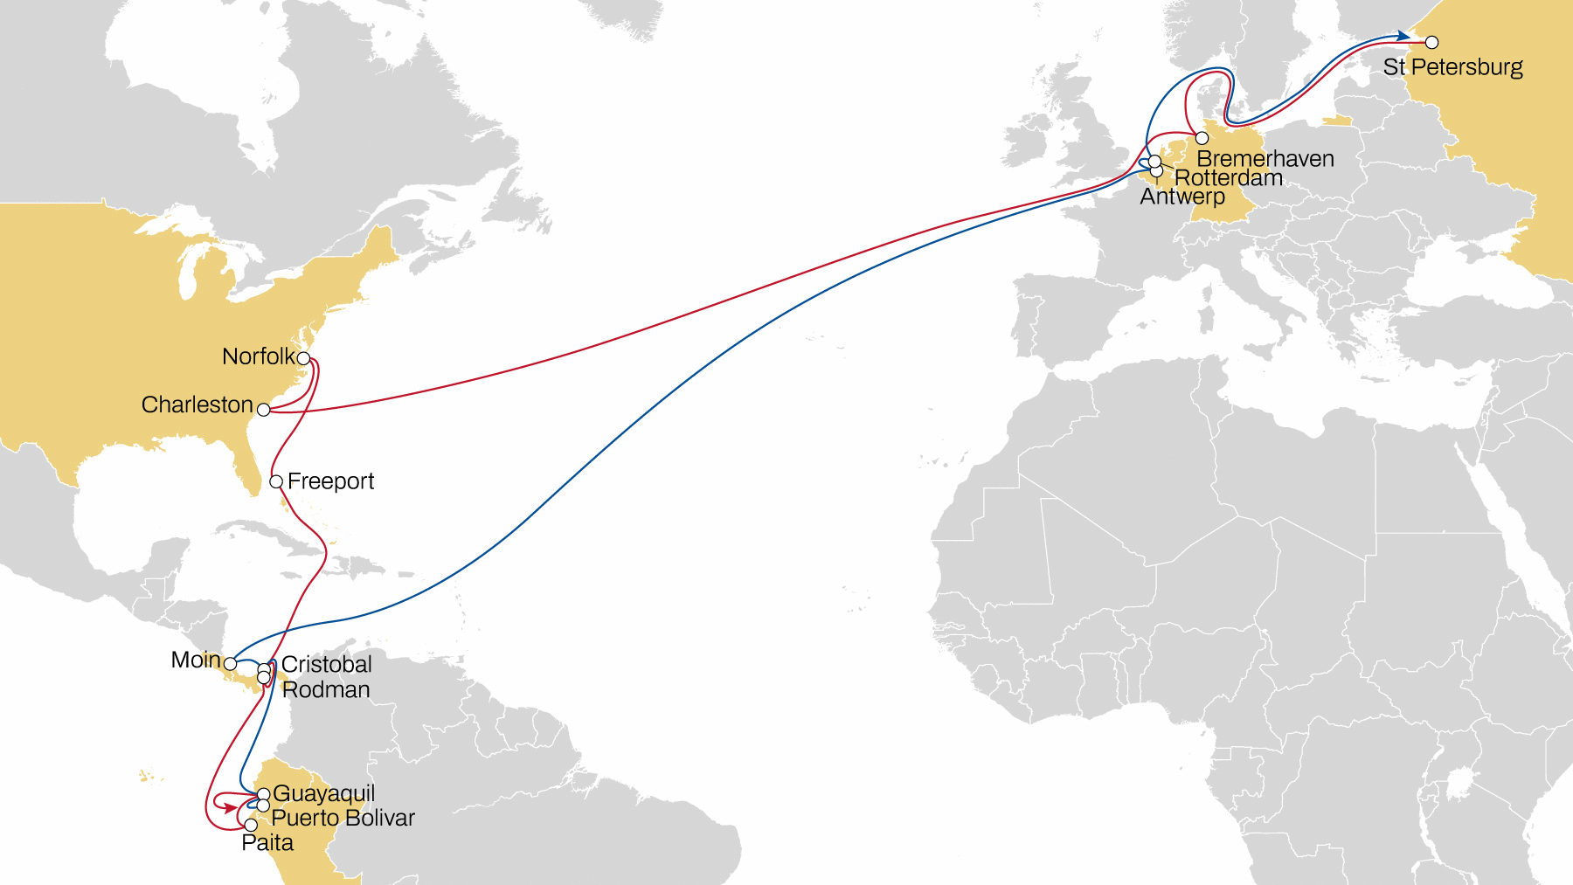
ECUADOR - NWC - USA
NORTH EUROPE to USA
AND ECUADOR
Weekly sailings
Exclusive Charleston and Norfolk service from Bremerhaven and Baltic
Transit Time | Arrival
Departure | Charleston | Norfolk | Freeport
St Petersburg | 14 | 16 | 18
Bremerhaven | 10 | 12 | 14
Note: Transit times are indicative and subject to change, please visit msc.com
For additional transit times, please contact the local MSC office.
To ensure you have the latest version of our flyers, please register online to get the latest updates as soon as they’re available.

Slide 8
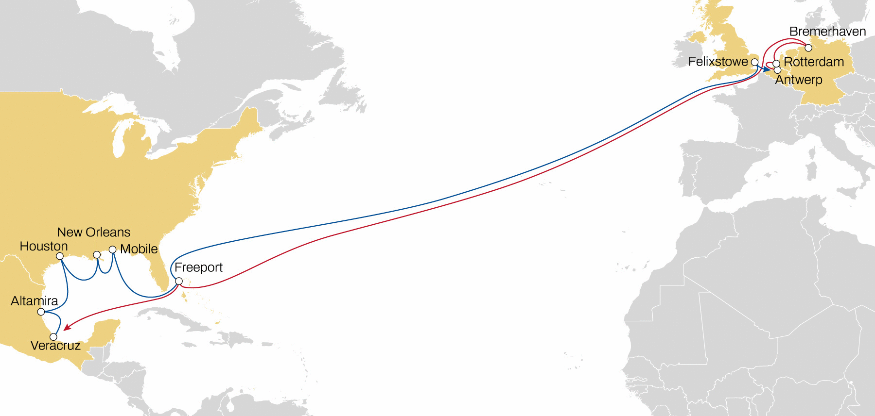
NWC TO USA
Mexico Gulf express
Weekly sailings
Most competitive transit times from NWC to Mexico and Houston with extensive Gulf coverage
Extensive coverage of the USA Gulf ports
Weekly connection to Jacksonville & Port Everglades in transhipment via Freeport
Transit Time | Arrival
Departure | Freeport | Veracruz | Altamira | Houston | New Orleans | Mobile
Felixstowe | 17 | 21 | 24 | 27 | 30 | 32
Antwerp | 15 | 19 | 21 | 25 | 28 | 30
Rotterdam | 13 | 17 | 19 | 23 | 26 | 28
Bremerhaven | 11 | 15 | 17 | 21 | 24 | 26
Note: Transit times are indicative and subject to change, please visit msc.com
To ensure you have the latest version of our flyers, please register online to get the latest updates as soon as they’re available.

Slide 9
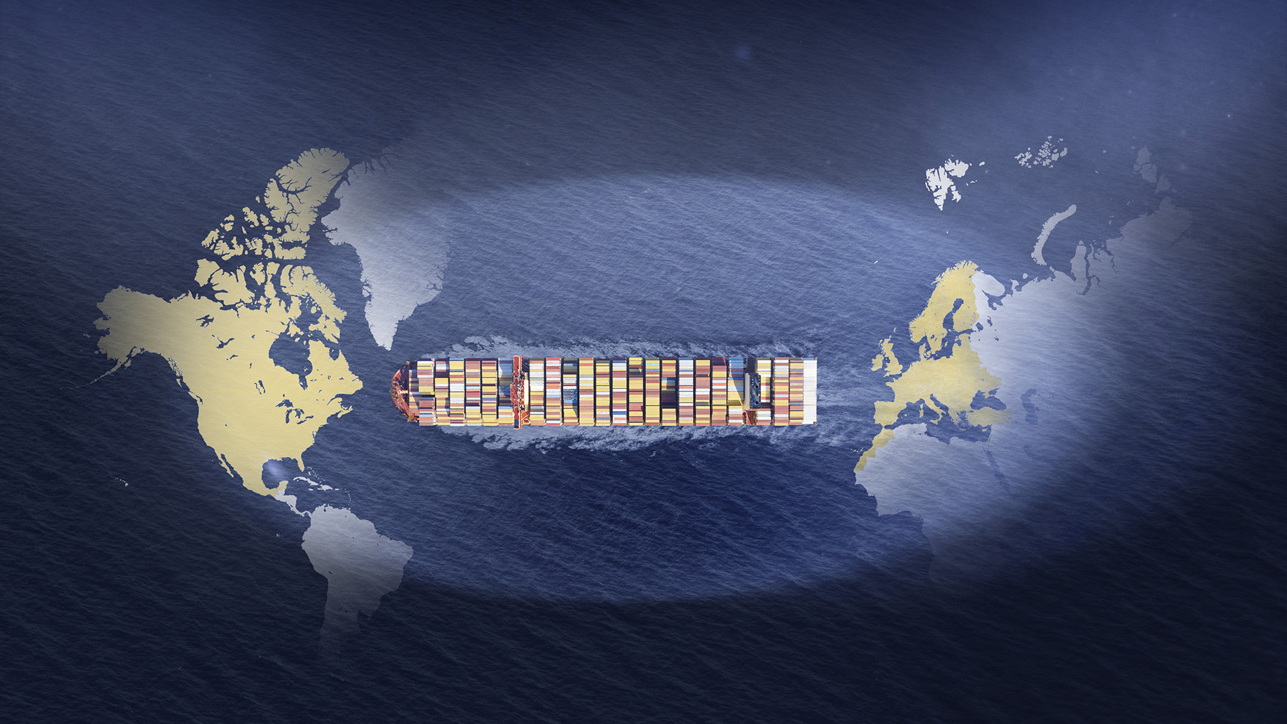
KEEP UP WITH OUR TRANSATLANTIC SERVICEs UPDATES
To ensure you have the latest version of our flyers, please register online to get the latest updates as soon as they’re available:
EUROPE – USA EUROPE – CANADA EUROPE – MEXICO

