Slide 1
Transpacific west coast usa & canada
March 2024

Slide 2
transpacific – west coast USA & Canada overview
PEARL | JAGUAR | ORIENT | MAPLE | CHINOOK | SENTOSA
VUNG TAU | SHEKOU | QINGDAO | XIAMEN | YANTIAN | PORT KLANG
HONG KONG | NANSHA | SHANGHAI | YANTIAN | SHANGHAI | SINGAPORE
YANTIAN | YANTIAN | NINGBO | NINGBO | QINGDAO | LAEM CHABANG
XIAMEN | NINGBO | BUSAN | SHANGHAI | BUSAN | VUNG TAU
 | SHANGHAI |  | BUSAN |  | BUSAN
 |  |  | YOKOHAMA
LOS ANGELES | LONG BEACH | LONG BEACH | PRINCE RUPERT | VANCOUVER | LOS ANGELES
 |  | OAKLAND | VANCOUVER | SEATTLE | OAKLAND
 |  |  |  | PORTLAND
YOKOHAMA | BUSAN | QINGDAO | YOKOHAMA | YANTIAN | BUSAN
SHANGHAI | SHANGHAI |  |  |  | QINGDAO
XIAMEN | SHEKOU |  | BUSAN |  | SHANGHAI
VUNG TAU |  |  | XIAMEN |  | NINGBO
 |  |  |  |  | SHEKOU
 |  |  |  |  | SINGAPORE
 |  |  |  |  | PORT KLANG

Slide 3
Eastbound

Slide 4
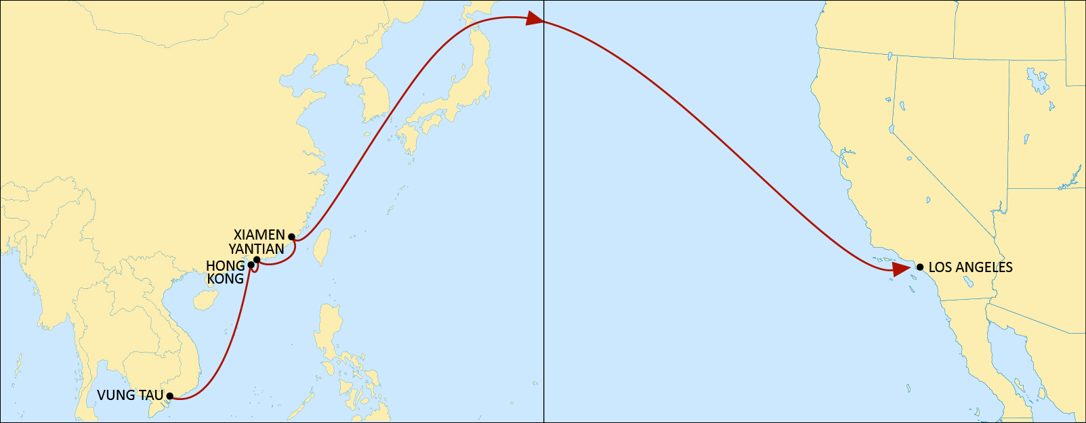
transpacific west coast usA
PEARL
Reliable Vietnam and South China product to the Pacific Southwest (Los Angeles P400) and US hinterland.
 | LOS ANGELES
VUNG TAU | 24
HONG KONG | 20
YANTIAN | 17
XIAMEN | 14
NOTE: Transit times are indicative and subject to change

Slide 5
transpacific west coast USA
JAGUAR
Alternative South China to PSW (Long Beach Pier T)
Competitive transit time from Ningbo and Shanghai
 | LONG BEACH
SHEKOU | 24
NANSHA | 22
YANTIAN | 20
NINGBO | 16
SHANGHAI | 13
NOTE: Transit times are indicative and subject to change

Slide 6
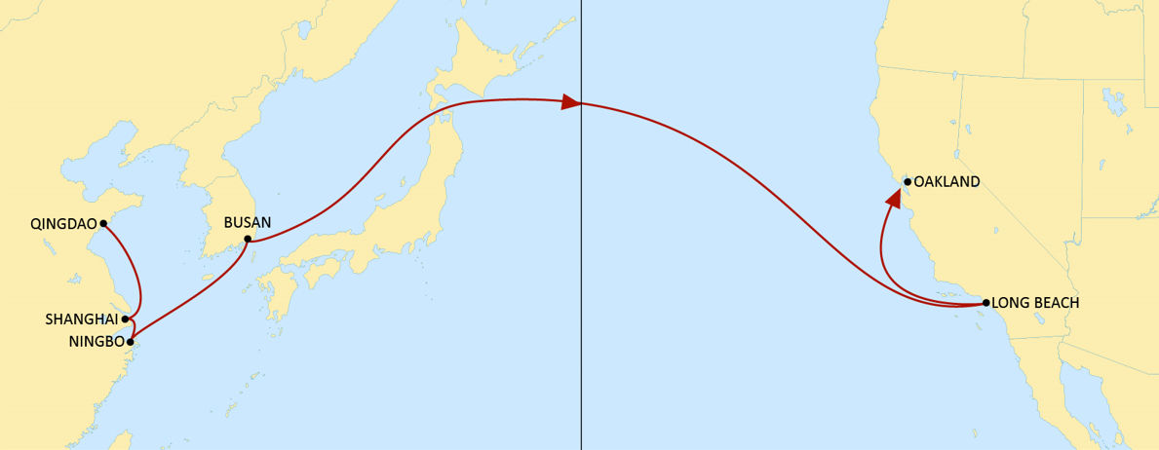
transpacific west coast USA
ORIENT
Improved transit time from North and Central China to Long Beach and Oakland
Direct South Korea coverage
 | LONG BEACH | OAKLAND
QINGDAO | 21 | 27
SHANGHAI | 17 | 23
NINGBO | 14 | 21
BUSAN | 12 | 18
NOTE: Transit times are indicative and subject to change

Slide 7
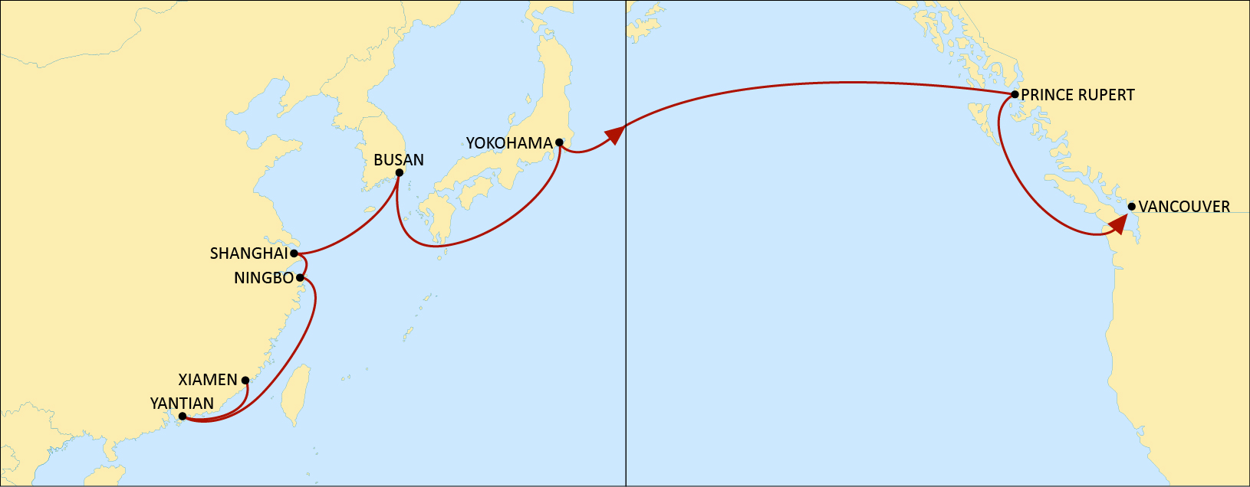
transpacific west coast CANADA
MAPLE
Dedicated Canadian service with both Vancouver and Prince Rupert call
Fast connection from China, South Korea and Japan to PNW
 | PRINCE RUPERT | VANCOUVER
XIAMEN | 22 | 27
YANTIAN | 19 | 24
NINGBO | 16 | 21
SHANGHAI | 14 | 19
BUSAN | 12 | 16
YOKOHAMA | 9 | 14
NOTE: Transit times are indicative and subject to change

Slide 8
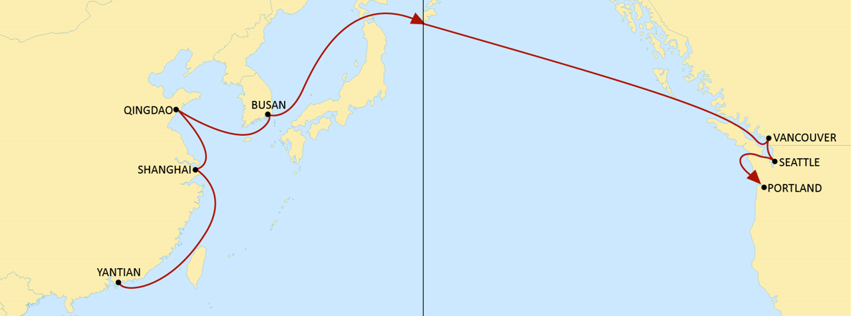
Transpacific WC USA & canada
CHINOOK
Fast transit time from Yantian, Shanghai, Qingdao and Busan to Vancouver
Weekly call to Seattle and Vancouver
 | VANCOUVER | SEATTLE | PORTLAND
YANTIAN | 19 | 22 | 25
SHANGHAI | 16 | 19 | 33
QINGDAO | 13 | 17 | 20
BUSAN | 11 | 14 | 17
NOTE: Transit times are indicative and subject to change

Slide 9
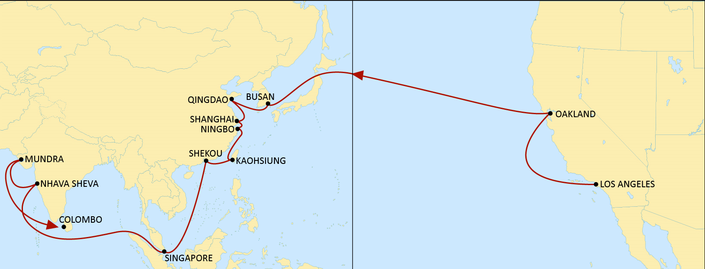
transpacific west coast USA
SENTOSA
Reliable India and Southeast Asia service to Los Angeles and Oakland
New calls in Mundra, Nhava Sheva, Colombo, Port Klang, Singapore and Busan with fast transit times to USWC.
Large improvement in transit from a large number of SEA ports via Busan.
 | LOS ANGELES | OAKLAND
PORT KLANG | 30 | 35
SINGAPORE | 28 | 34
LAEM CHABANG | 22 | 28
VUNG TAU | 19 | 25
BUSAN | 12 | 18
NOTE: Transit times are indicative and subject to change

Slide 10
westbound

Slide 11
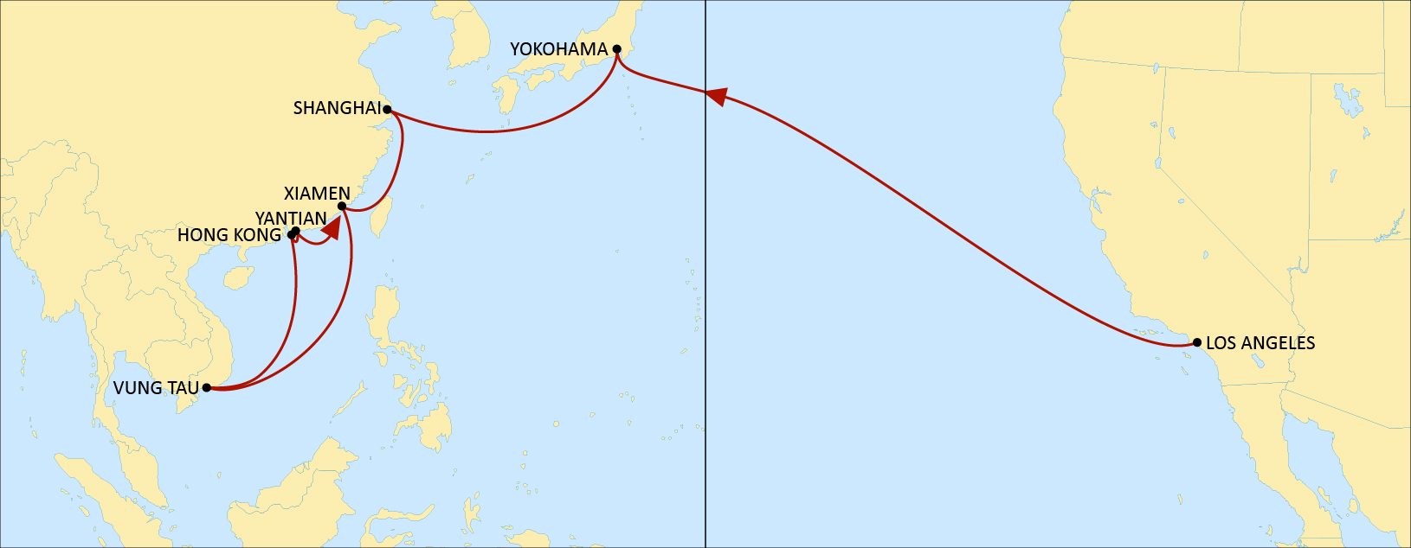
transpacific west coast USA
PEARL
Direct service to Yokohama
Reliable connection Xiamen
Fast transit time to Vung Tau
 | YOKOHAMA | XIAMEN | VUNG TAU | HONG KONG | YANTIAN
LOS ANGELES | 18 | 22 | 31 | 36 | 38
NOTE: Transit times are indicative and subject to change

Slide 12
transpacific west coast USA
JAGUAR
Reliable connection to Busan
Direct service to Shekou, Nansha, Yantian and Ningbo.
 | BUSAN | SHEKOU | NANSHA | YANTIAN | NINGBO | SHANGHAI
LONG BEACH | 20 | 24 | 26 | 28 | 32 | 35
NOTE: Transit times are indicative and subject to change

Slide 13
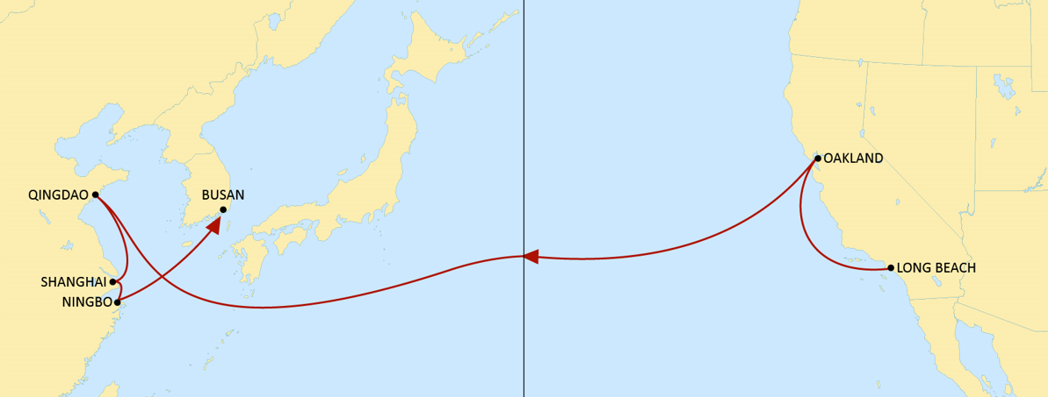
transpacific west coast USA
ORIENT
Reliable connections to North and Central China
 | QINGDAO | SHANGHAI | NINGBO | BUSAN
LONG BEACH | 22 | 26 | 29 | 31
OAKLAND | 17 | 21 | 24 | 26
NOTE: Transit times are indicative and subject to change

Slide 14
transpacific west coast CANADA
MAPLE
Dedicated service from Canada to Yokohama
Reliable connections to Xiamen, Yantian, Ningbo & Shanghai.
 | YOKOHAMA | BUSAN | XIAMEN | YANTIAN | NINGBO | SHANGHAI
PRINCE RUPERT | 22 | 25 | 29 | 32 | 35 | 37
VANCOUVER | 17 | 20 | 24 | 27 | 30 | 32
NOTE: Transit times are indicative and subject to change

Slide 15
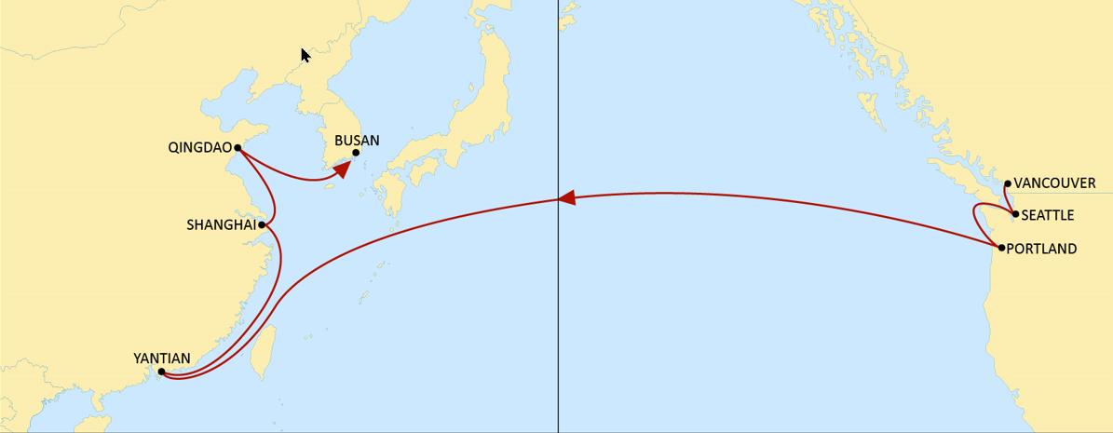
Transpacific WC USA & canada
CHINOOK
Weekly Seattle & Portland call to China
Reliable connection in Busan
 | YANTIAN | SHANGHAI | QINGDAO | BUSAN
VANCOUVER | 19 | 22 | 24 | 26
SEATTLE | 17 | 19 | 22 | 24
PORTLAND | 15 | 17 | 20 | 22
NOTE: Transit times are indicative and subject to change

Slide 16
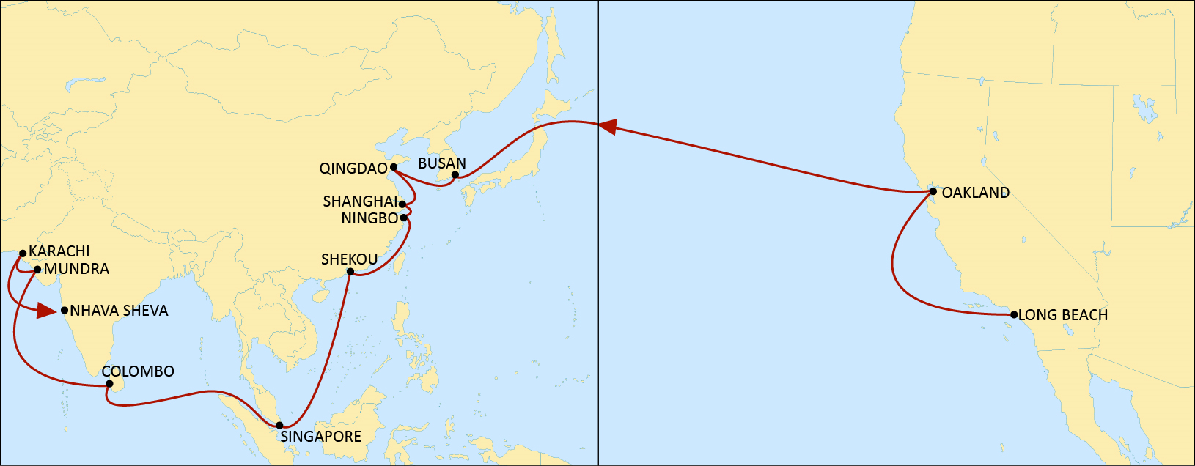
transpacific west coast USA
SENTOSA
Direct connection to China, Southeast Asia and India.
 | BUSAN | QINGDAO | SHANGHAI | NINGBO | SHEKOU | SINGAPORE | COLOMBO | MUNDRA | KARACHI | NHAVA SHEVA
LOS ANGELES | 16 | 20 | 23 | 24 | 28 | 33 | 39 | 44 | 46 | 48
OAKLAND | 14 | 17 | 20 | 21 | 25 | 30 | 36 | 41 | 43 | 46
NOTE: Transit times are indicative and subject to change

